Slide 1
DESI FOOD ON WHEELS
STATIC FOOD POINT
DESI FOOD ON WHEELS

Slide 2
Members
MEMBER 1
MEMBER 2
MEMBER 3

Slide 3
STAKE HOLDERS
University Administration
Students
Faculty and Staff
Food Vendors
Local Community
Health and Safety Authorities
Environmental Agencies
Investors or Financers
Competitors
Neighboring Businesses

Slide 4
Main Contents of this Presentation
1 | Introduction
2 | Sequence of Events
3 | Cost Breakdown
4 | Investment Appraisal
5 | Legislation
6 | Design
7 | Risk Analysis
8 | Gantt Chart and Network diagram

Slide 5
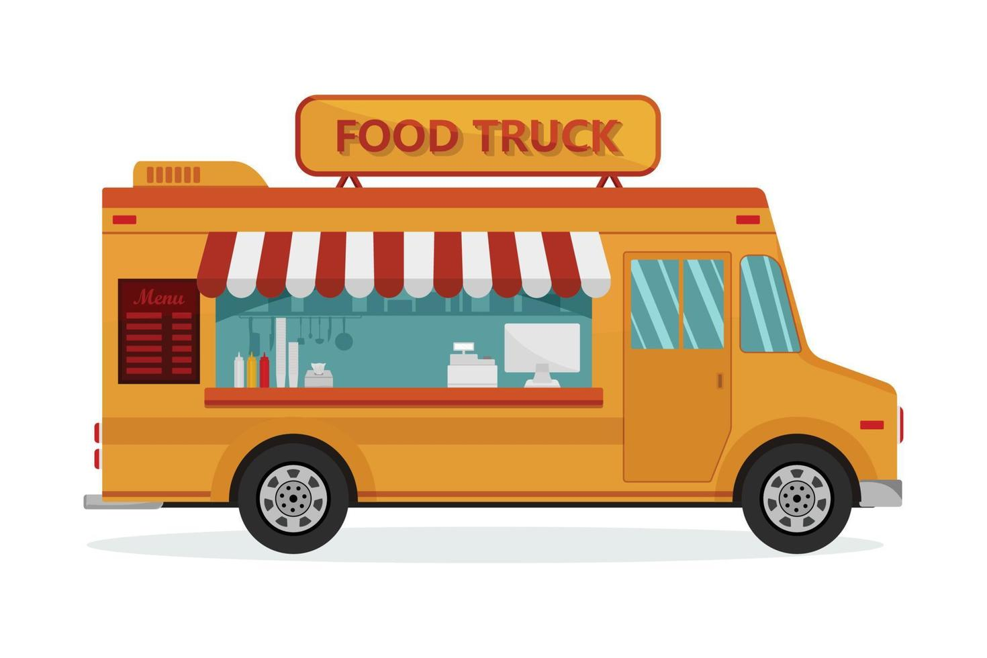
Introduction
The Proposal Body advocates integrating food vans into the university campus and will offer deluxe cuisine to suit the parties and events needs of all students during their dining experience
The service is structured around the mixed and dynamic appetite of our student, faculty, and staff population.
As both food trucks and street vendors are the sources of diverse foods, they will let one encounter a wide variety of cuisines from different parts of the world and special dietary meals.

Slide 6
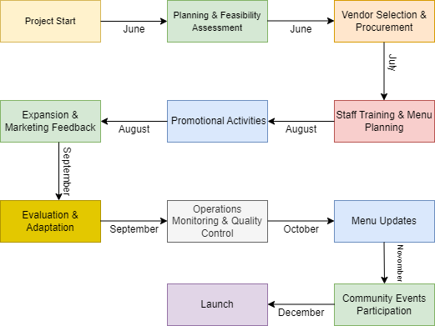
Sequence of events

Slide 7
Project Justification
Convenience:
Accessibility
Flexibility
The food van and menu station situated on campus serve as an onsite dining option which takes less time for campus workers to fetch other food items as they are all there.
The humble food van provides various locations within the university community, which helps us to make sure that we all have the opportunity to enjoy quality food options.
Distinguished from the station restaurants, the van is nimble enough to be transferred to different locations bringing the food to students, especially during changeable occasions and events on campus.

Slide 8
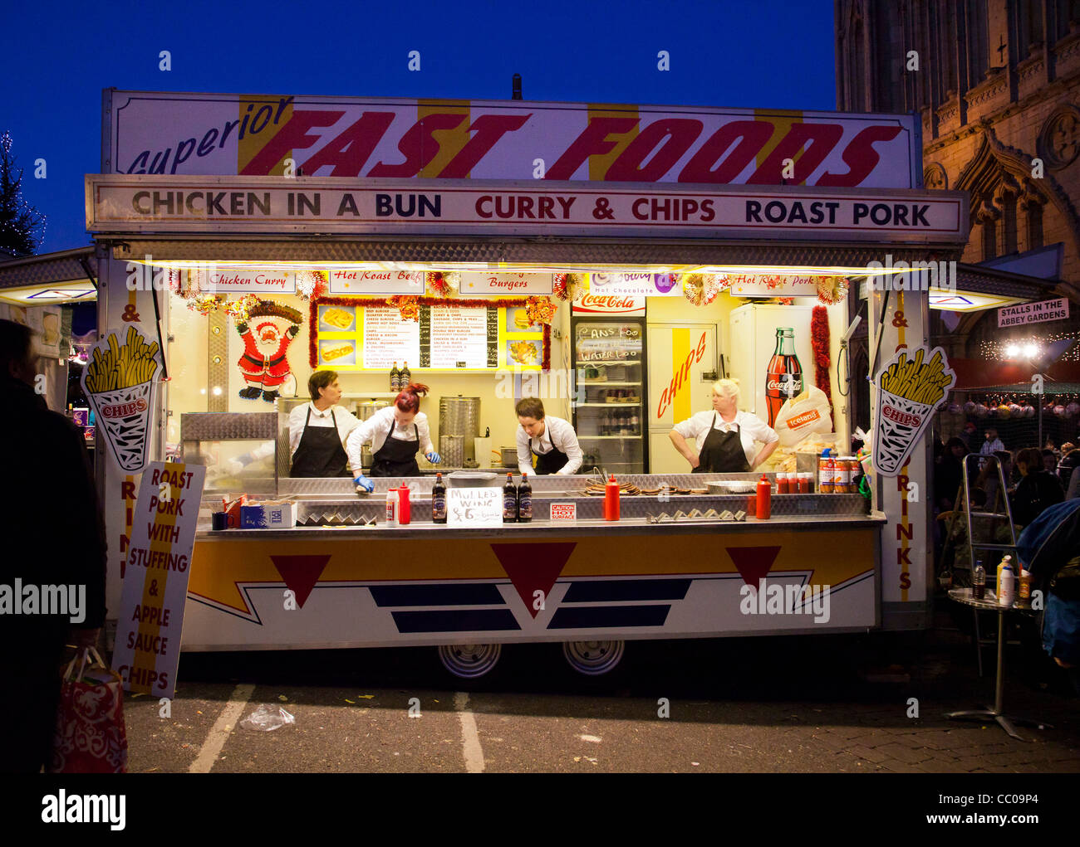
Product Justification
Variety:
The food van on the university campus operates with a varied menu; which has various types of dishes including vegan and non-vegan food options. Hence they can satisfy almost anyone's taste
Community Engagement:
The food van on campus, in addition to being a source of delicious fare, becomes a meeting point where individuals communicate with one another, share food, and develop a sense of belonging.

Slide 9
Options
Static Food Point
Desi Food on Wheels
Offer a rest to people, supporting them in having a reliable eating spot. Constant supply of the right eating options Accessible specifically for students, faculty, and staff is especially convenient due to its location. this gives them peace of mind in knowing where to access the food vendor. Combines easiness of management, and operations in one. Fixed dining complexes and delimited space to eat.
Apart from being the centerpiece of the campus, the bridge extends its presence to all corners of the University. Reducing hunger among a growing number of people who often don’t have a place to eat. The whole college, staff, and student population. can adjust by the level of demand and flow of the clients. Nurture a new level of connection between people. are tested for culinary expertise and community spirit. moves around the campus

Slide 10
Cost Break Down Details option 1
Cost Component | Estimated Cost
Setup and Equipment(Shop) | £200,000
Permits and Licenses | £20,000
Ingredients and Supplies | £50,000
Initial Inventory | £30,000
Promotional Materials And digital marketing | £20,000
Total Project Cost | £320,000

Slide 11
Cost Break Down Details option 2
Cost Component | Estimated Cost
Purchase of Food Van | £150,000
Customization and Branding | £20,000
Initial Inventory | £20,000
Marketing and Promotion | £10,000
Permit and License Acquisition | £10,000
Contingency Fund | £10,000
Total Cost | 220,000£

Slide 12
Cash flow option 1
Year | Cash Flow
1 | Net Cash Flow = Total Cash Inflows – Total Cash Outflows. (£55,000)
2 | £55,000
3 | £60,000
4 | £65,000
5 | £70,000
6 | £75,000
7 | £80,000
8 | £85,000
9 | £90,000
10 | £95,000

Slide 13
Cash flow option 2
Year | Cash Flow
1 | Net Cash Flow = Total Cash Inflows – Total Cash Outflows. (£55,000)
2 | £55,000
3 | £60,000
4 | £65,000
5 | £70,000
6 | £75,000
7 | £80,000
8 | £85,000
9 | £90,000
10 | £95,000

Slide 14
Investment appraisal option 1
Data | Value
Initial Investment | 250,000£
Annual Income | 40,000£
Operating Costs | 230,000£
Food point rent | 25,000£(Annual)
Calculations | Results
Payback Period | £250,000 / £40,000 = 6.2.5 years (rounded up to 7 years)
NPV | $171,685.07
Average Accounting Return(ARR) | 20.67%
Internal Rate of Return (IRR) | Approximately11.993%

Slide 15
Investment appraisal option 2
Data | Value
Initial Investment | £250,000
Annual Income | £50,000
Operating Costs | £200,000
Food Van Maintenance | £1500
Calculations | Results
Payback Period | £250,000 / £50,000 = 5 years
NPV | $171,685.07
Average Accounting Return(ARR) | 31%
Internal Rate of Return (IRR) | Approximately 21.193%

Slide 16
Legislation
Licensing and Permits: Get all licenses and permits needed by the local authority involving business, food safety, and food handler’s permits.
Zoning and Location: Be sure to have a look at the campus zoning rules if one would like to know possible areas for the business on campus.
Tax Obligations: Make sure to meet the tax requirements connected with sales tax, income tax, and other relevant tax laws.

Slide 17
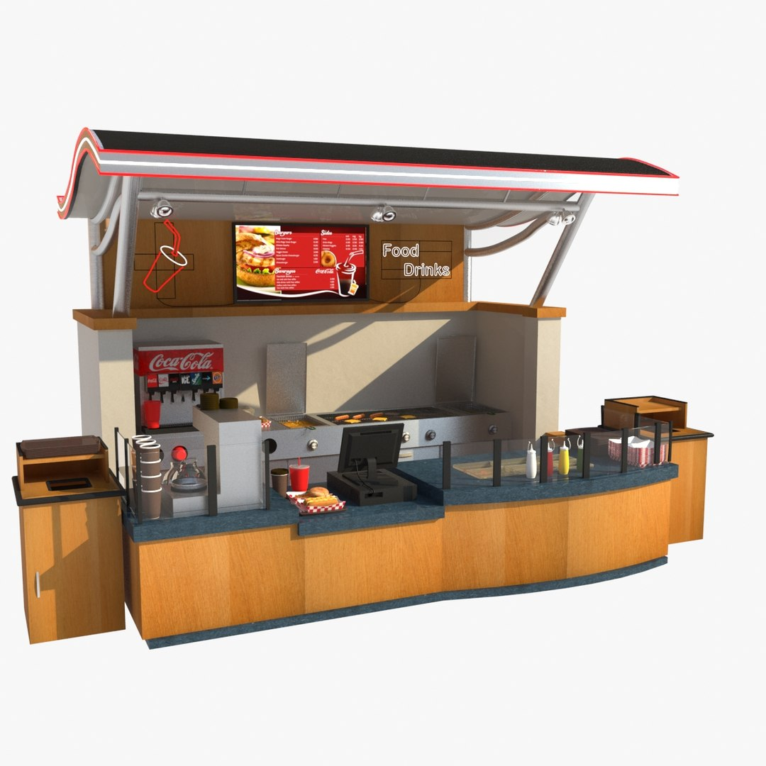
Design: FOOD POINT

Slide 18
Design: DESI FOOD ON WHEELS

Slide 19
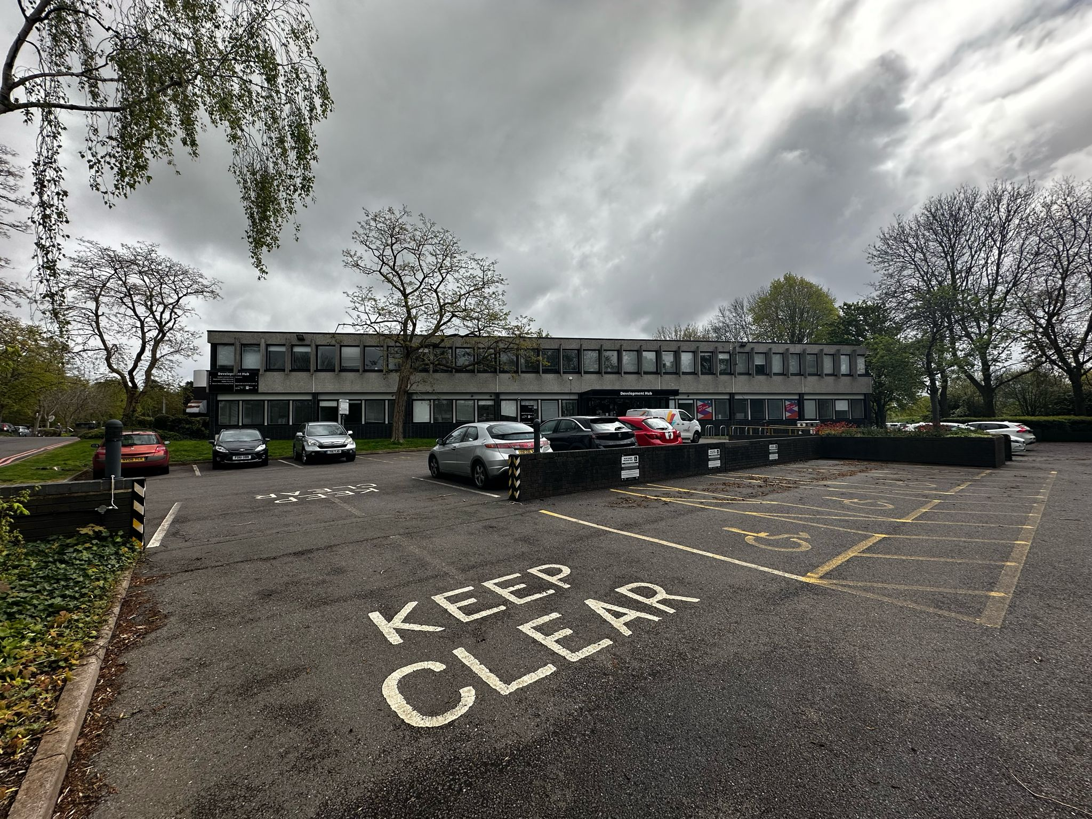
LOCATION FOR DESI FOOD ON WHEELS

Slide 20
Sustainability
Local Sourcing: Both models can prioritize local sourcing of ingredients that decrease the carbon footprint from product transportation and, in turn, reduce the negative environmental impacts of long-distance transport of the goods and support local farmers and producers.
Reduced Food Waste: With proper stock control and paying attention to the serving sizes, both choose to reduce the waste of food, thus making the environment cleaner.
Reusable and Biodegradable Packaging: Introducing reusable or biodegradable alternatives of packaging options will help to cut down the single-use plastic waste and hence, the positive effect will be created on the environment.
Energy Efficiency: Be it the electric van or the place permanently on the spot both can invest in energy-efficient equipment and appliances which will help to reduce energy consumption as well as greenhouse gas emissions.

Slide 21
Sustainability: Option 1
Sustainability: Option 2
Sustainability Aspect | Implementation
Community Engagement: | The local community is building its relationship with responsible consumption of food through sustainable food gatherings, events, and education programs that can leverage this consciousness.
Student Engagement | Use interactions to help the student fully grasp the business and how the local establishments operate.
Green Technologies | All technologies should be developed with environment-protecting principles to be consistent with the aims of sustainability.
Sustainability Aspect | Implementation
Mobile Operations | Food trucks can go where people are in their everyday lives, feeding diverse communities and lowering transport emissions by integrating electrified vehicles which optimize routes.
Energy-Efficient Appliances | Initiations of energy-saving devices and eco-friendly machinery, including low-emission generators and eco-friendly cooking devices.
Alternative Fuels | Alternative fuels like biodiesel or electric power not only can significantly lower carbon emissions and depletion of fossil fuels, but they can also be substitutes for fossil fuels.

Slide 22
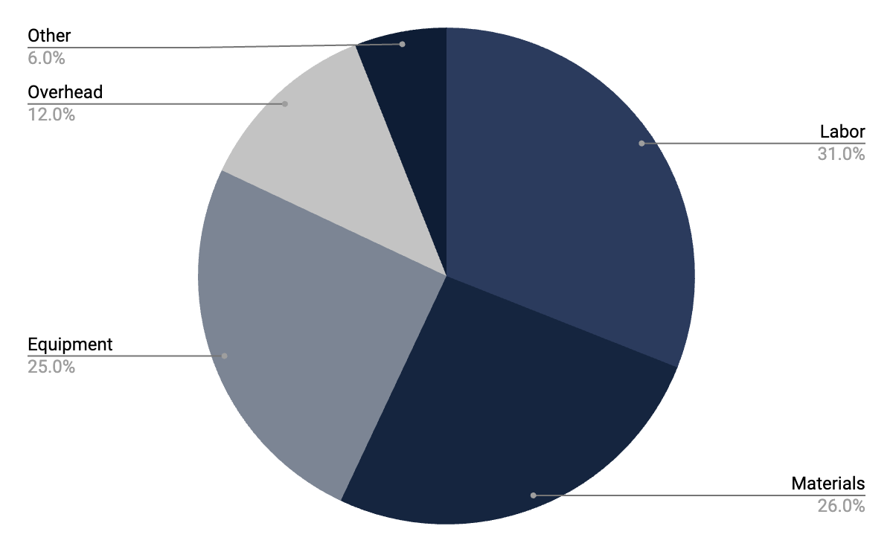
Project expenses
Staff/Labor
Materials
Equipment
Overhead
Other

Slide 23
Total Quality Management Plan

Slide 24
Risk Analysis: Food Point(Static Food Van)
Risk Description | Impact | Likelihood | Risk =impact x likelihood | Action
High upfront costs | 5 | 4 | 20 | Explore financing options
Location Suitability | 5 | 2 | 10 | Find best stop convenient for everyone
Competition | 4 | 5 | 20 | Sell quality food
Operational Costs | 4 | 2 | 8 | Optimize the overall expenses
Lease Agreement | 2 | 1 | 2 | Collaborate with authorities

Slide 25
Risk Analysis:Food Van
Risk Description | Impact | Likelihood | Risk =impact x likelihood | Action
High initial investment | 3 | 2 | 6 | Seek additional funding
Weather Dependency | 2 | 4 | 8 | Monitor and adjust
Mobility Restrictions | 4 | 4 | 16 | Make path throughout Campus
Vehicle Breakdowns | 5 | 2 | 10 | Hire Mecahnic or have additional van
Supply Chain Disruptions | 3 | 3 | 9 | Regular checkup on stock

Slide 26
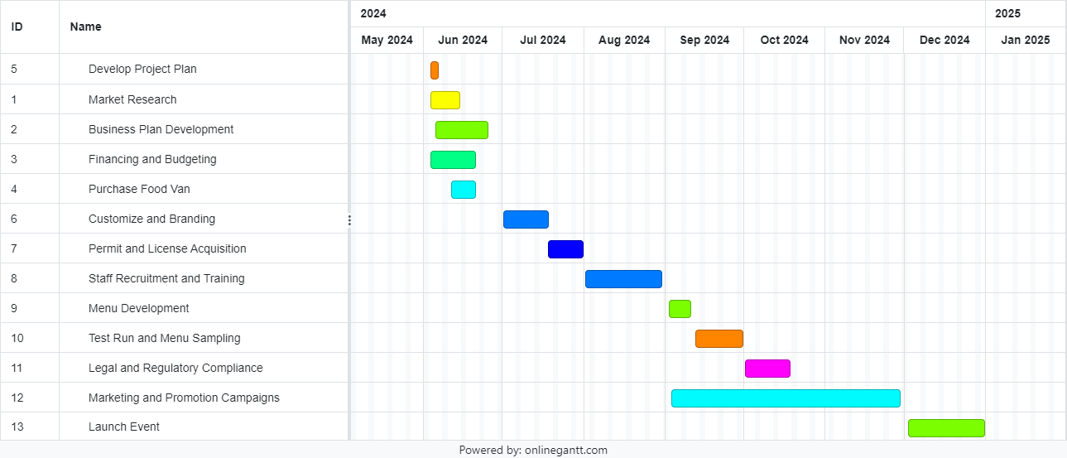
Gantt Chart(Desi Food on Wheels)

Slide 27
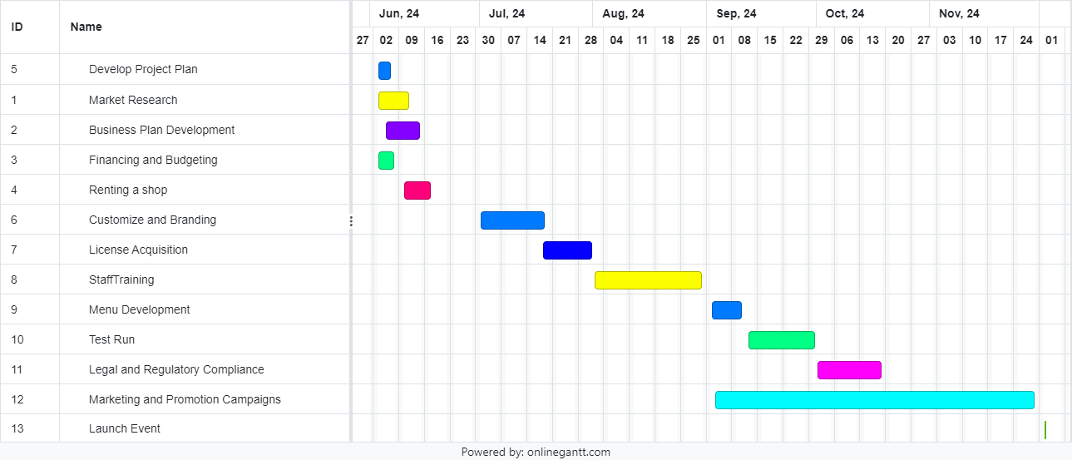
Gantt Chart(Static Food Point)

Slide 28
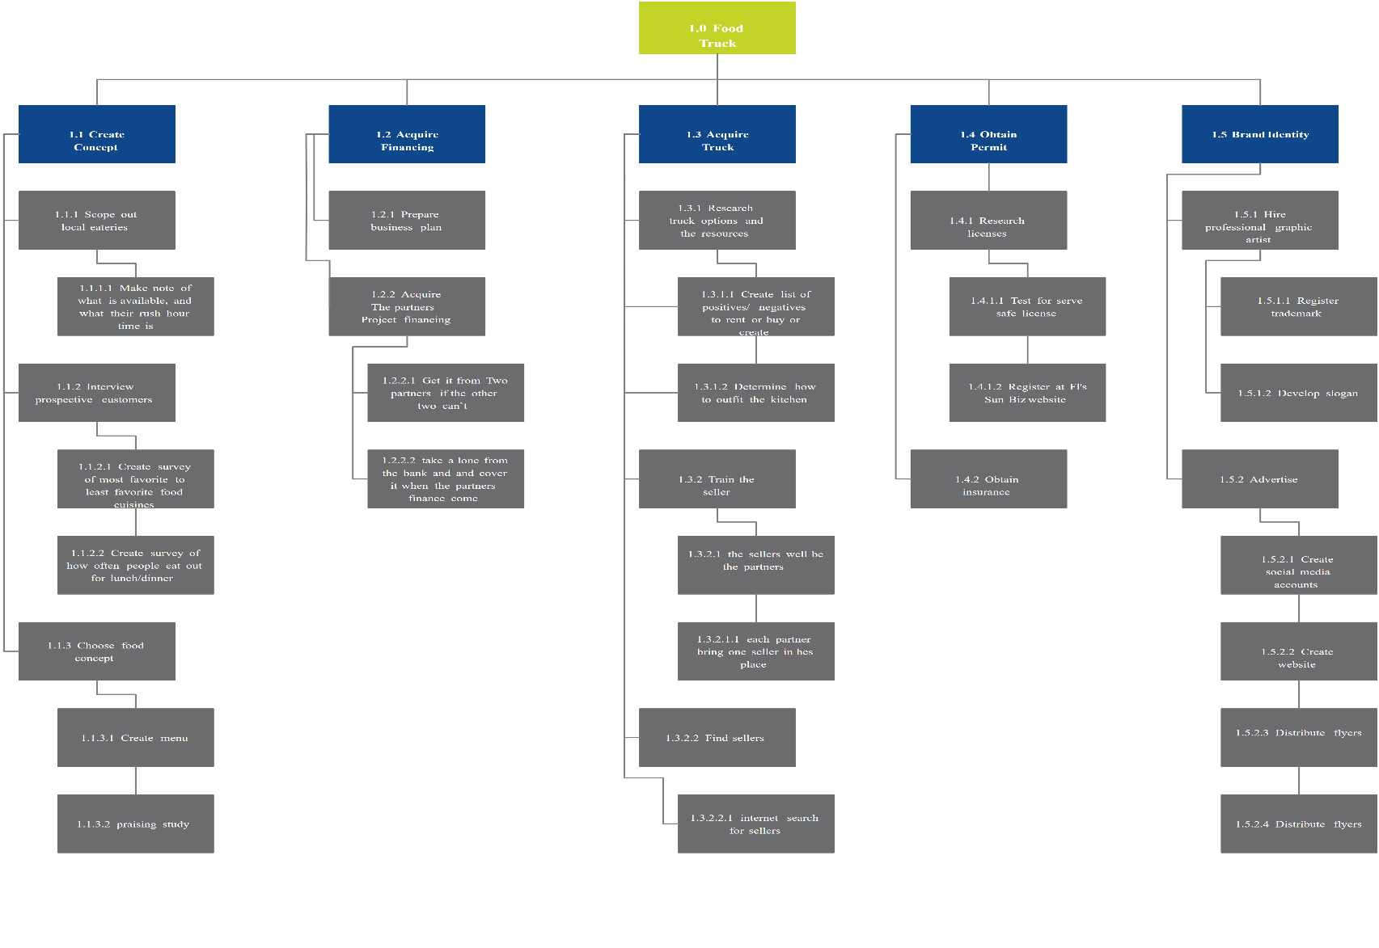
Network Diagram

Slide 29
DESI FOOD ON WHEELS > FOOD POINT
Mobility and Flexibility:
The main advantage of this app is the ability to find the locations.
Is a dynamic environment characterized by continuous adaptation, to changes in customer demand and social events.
Lower Overhead Costs:
Lessen the costs fixed in comparison to a permanent location.
No rent, electric bill, or another announcement month.
Wider Customer Reach:
Expands the market and touches different customer groups. Beautiful but meaningful outline!
Location of the store: prime spots for tourists and passers-by, close to major events.

Slide 30
Conclusion
At the tube station, the choice between a snack bar in a parked van and one in a regular restaurant is based on comprehensive factors.
The mobility of a food truck gives it the flexibility to approach different customers in their neighborhood and change it with the weather: the good cheer or cold winter.
In a way the food spot ensures accessibility and the company gains greater visibility thanks to a location that is not movable, hence the customers are offered a platform for constant recreation.
Both food on the move and food at the static points, have some of the innate advantages and problems, with the stationary food point having more customers but the easier distribution of the food on the move.

Slide 31
References
Entrepreneur Media, Inc. (2012). Food truck business: Entrepreneur’s step-by-step startup guide. Retrieved from https://irp-cdn.multiscreensite.com/
Hansson, J. (2003). Total Quality Management -Aspects of Implementation and Performance Investigations with a Focus on Small Organisations. Retrieved from https://www.diva-portal.org/smash/get/diva2:999931/FULLTEXT01.pdf
Mintzer, R. (2015). Start Your Own Food Truck Business: Cart Trailer Kiosk Standard and Gourmet Trucks Mobile Catering Bustaurant. Google Books. Entrepreneur Press. Retrieved from https://books.google.com.pk/books/about/Start_Your_Own_Food_Truck_Business.html?id=nAL3BwAAQBAJ&redir_esc=y
Palacio, M. (2008). Introduction to Foodservice. Retrieved from https://juradybydu.files.wordpress.com/2014/07/introduction-to-foodservice.pdf

Slide 32

THANKS

